Slide 1
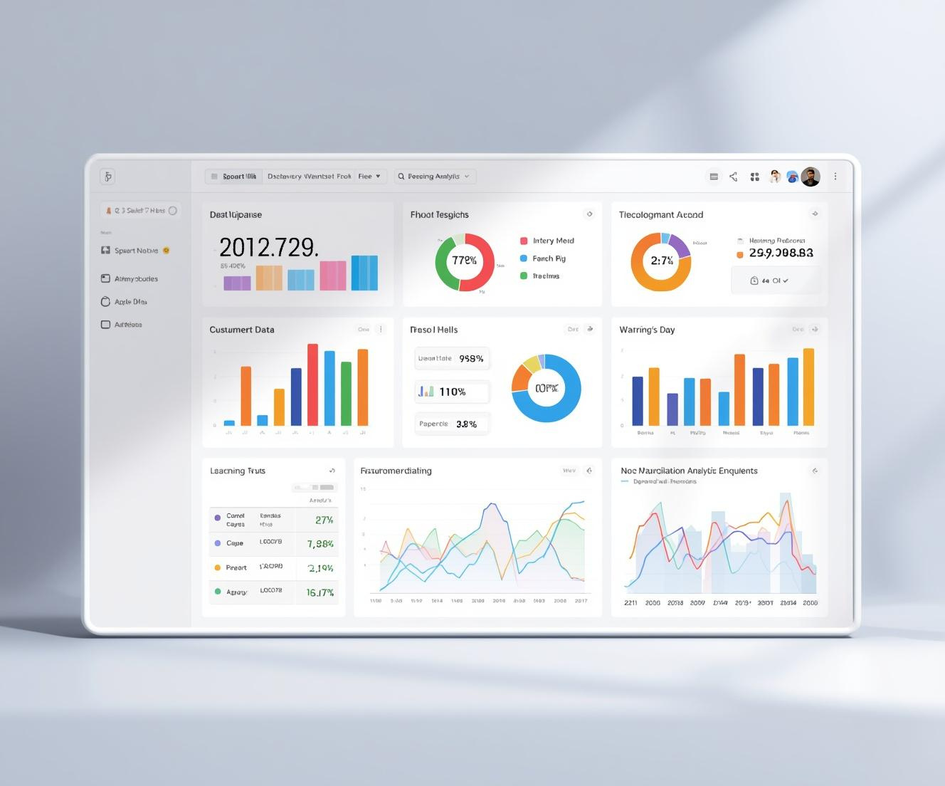
Customer Shopping Behavior Analysis
Shaik Naved Ahmed - 2303A54053
Pathalavath Srinivas - 2303A54067

Slide 2

Introduction
Unveiling customer insights through advanced data analysis techniques
Understanding customer shopping behavior is crucial for businesses aiming to enhance their strategies. By leveraging tools such as Python, SQL, and machine learning, we can extract valuable insights from data. This analysis equips organizations with the knowledge needed to tailor their offerings and improve customer engagement effectively.

Slide 3



Objectives
Actionable Insights
Trend Analysis
Customer Segmentation
Leveraging data for informed business decisions
Understanding patterns across various customer categories
Tailoring strategies for diverse consumer groups

Slide 4

Key Stakeholders in the Analysis
Stakeholder Impact
Business owners and teams drive data-driven decision-making.

Slide 5
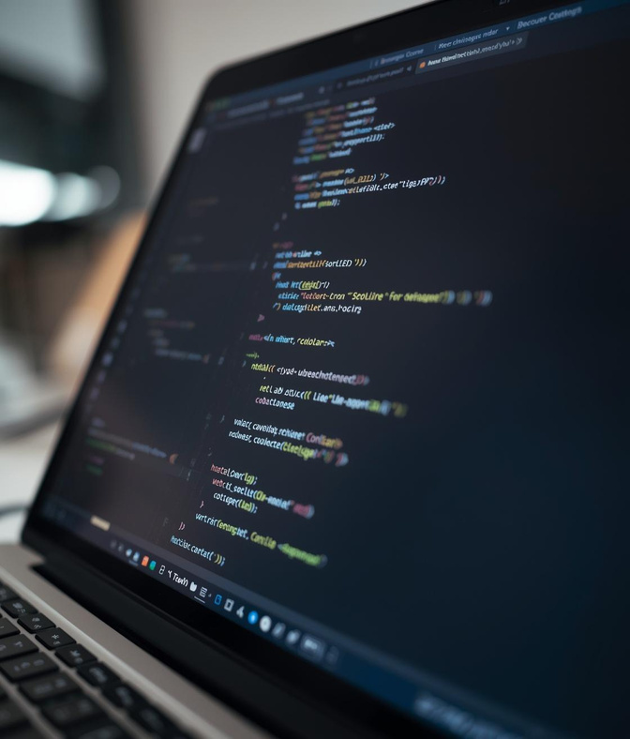
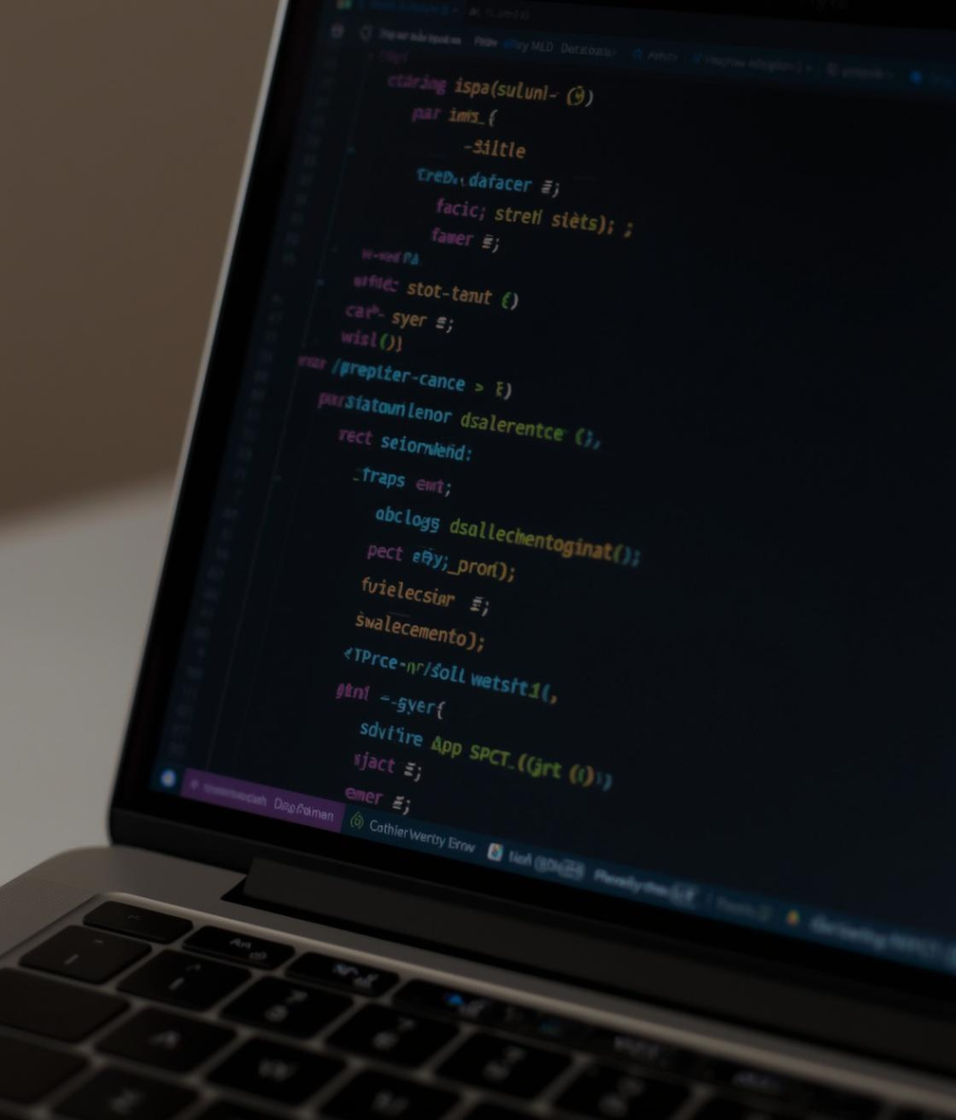
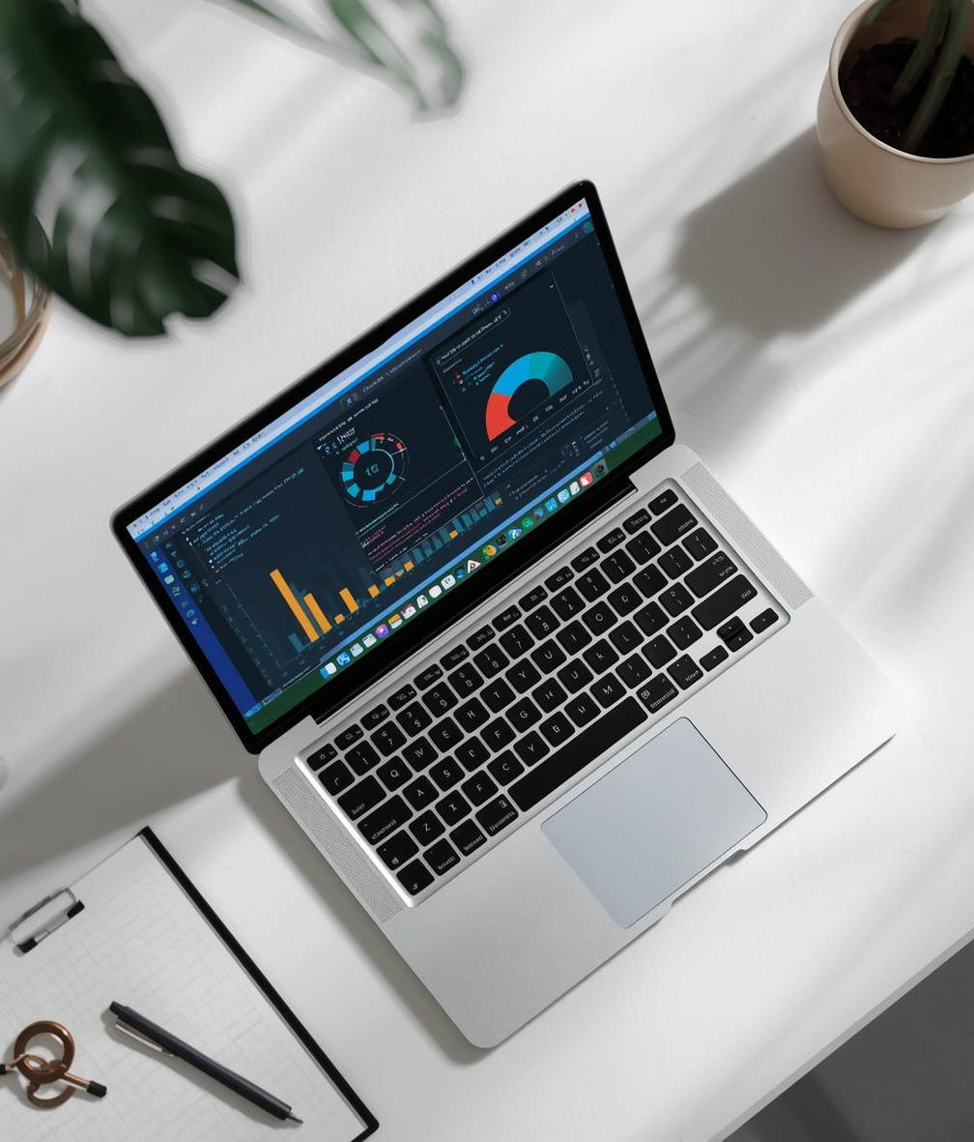
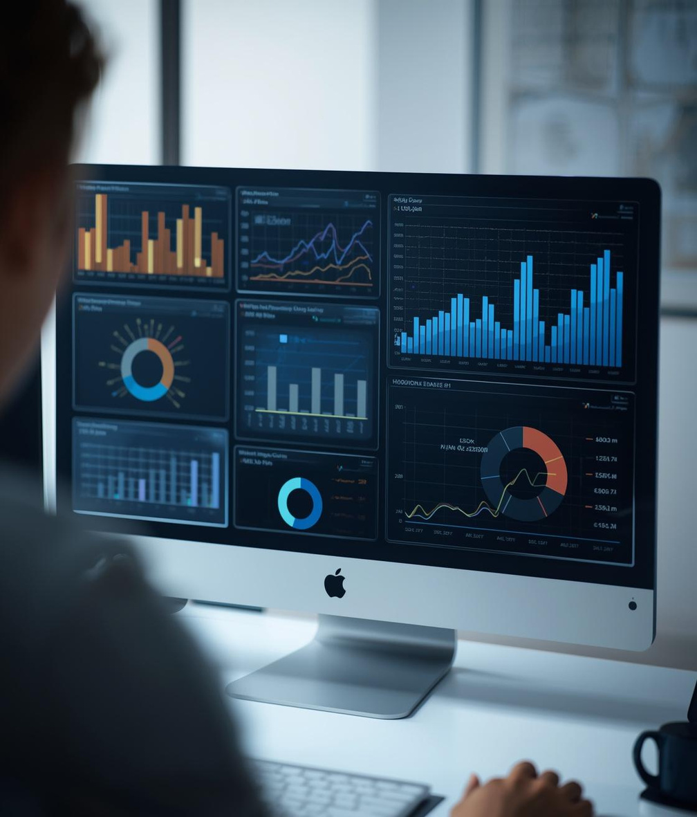
Programming Languages and Tools
Python
SQL
Jupyter Notebook
Data Visualization
Powerful language for data analysis and manipulation
Essential for managing relational databases efficiently
Interactive platform for coding and visualization
Communicates insights through compelling graphics

Slide 6
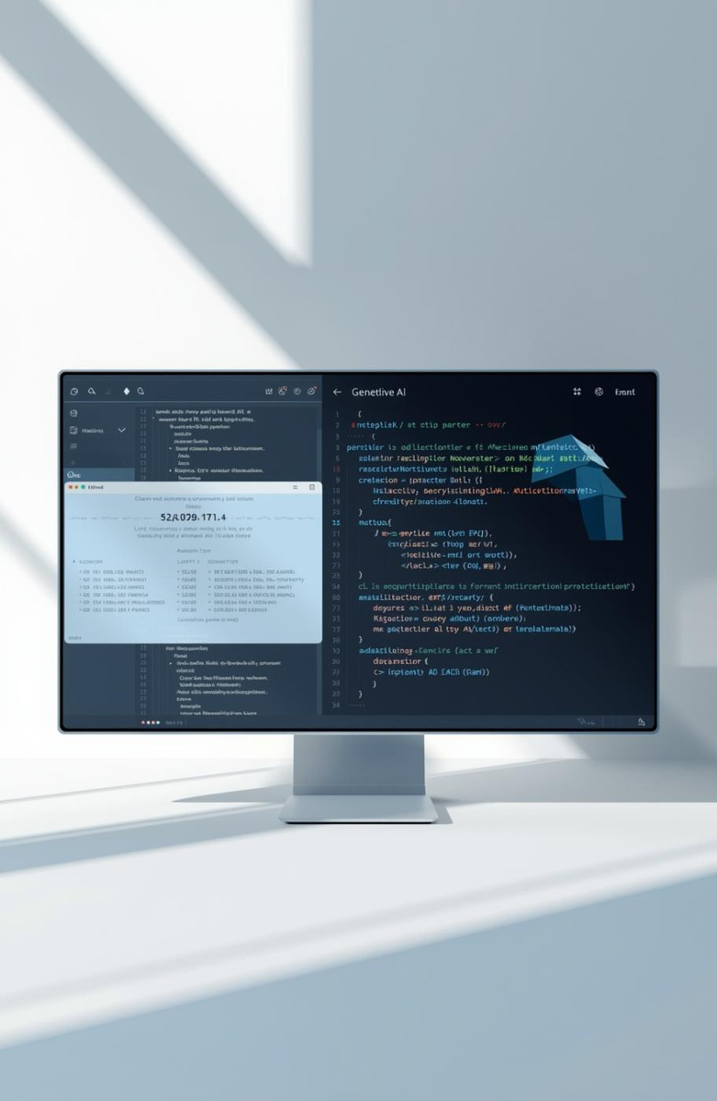
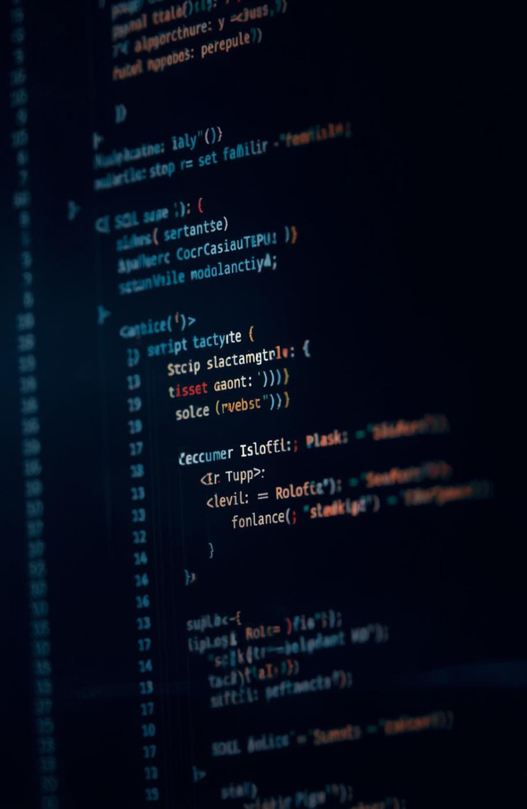



EDA Process
SQL Query
Regression Model
Seasonal Trends
Code Generation
Exploring data relationships for insights
Extracting valuable data insights efficiently
Predicting future purchases accurately
Understanding customer behavior variations
Automating tasks with AI assistance
Key Prompts for Analysis

Slide 7



Workflow
Data Collection
Data Cleaning
Analysis Process
Gathering relevant data for analysis.
Ensuring data quality through preprocessing steps.
Applying techniques to derive business insights.

Slide 8
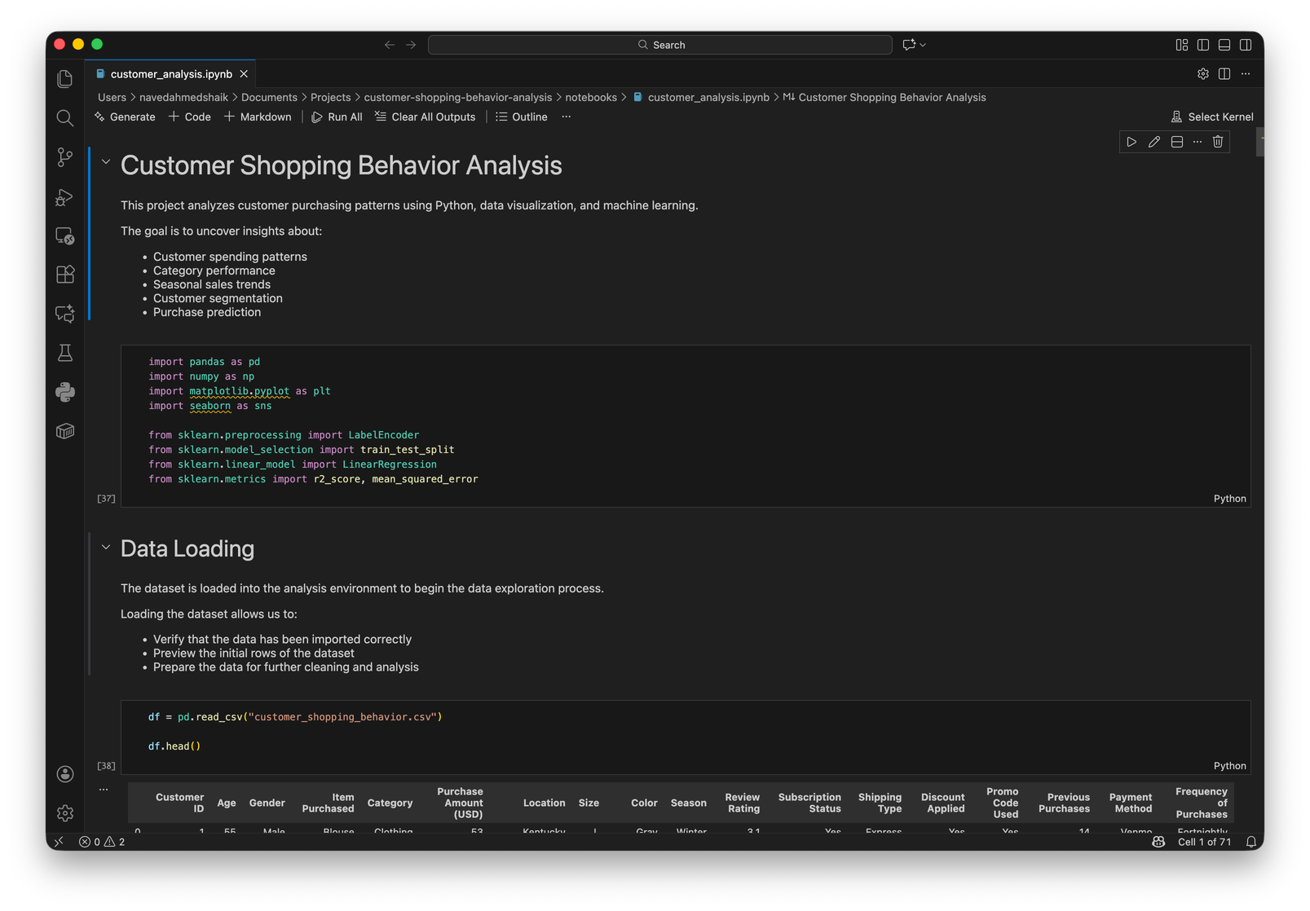
Frontend View of Notebook
Notebook Interface
Visual representation of data analysis and insights.

Slide 9
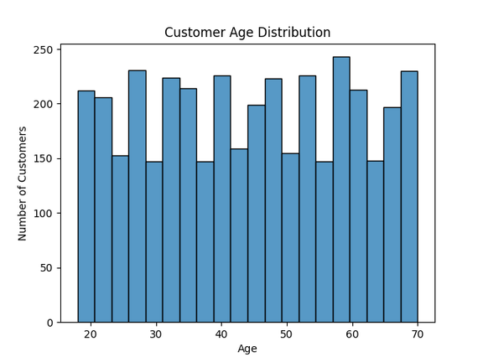
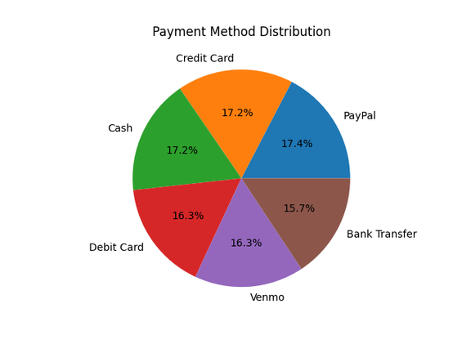
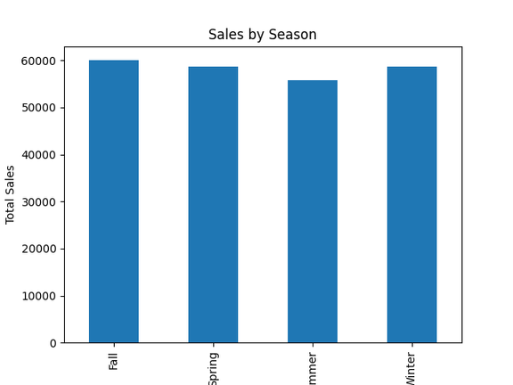
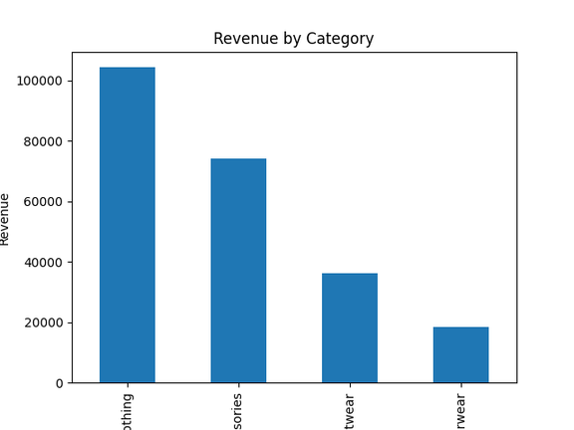
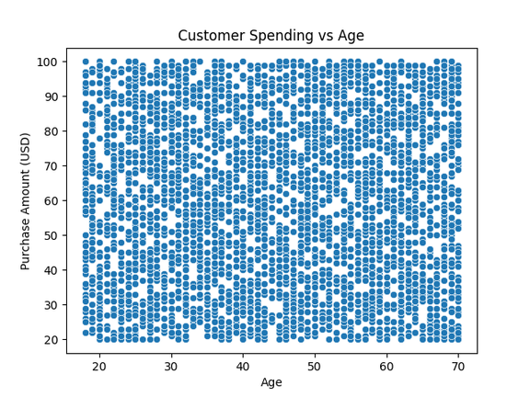
Output
Graphs

Slide 10
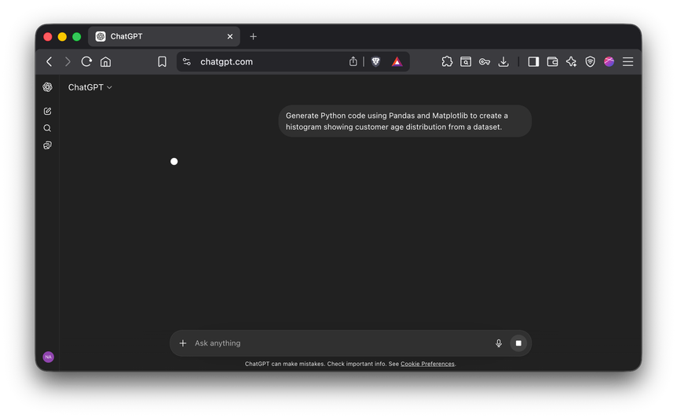
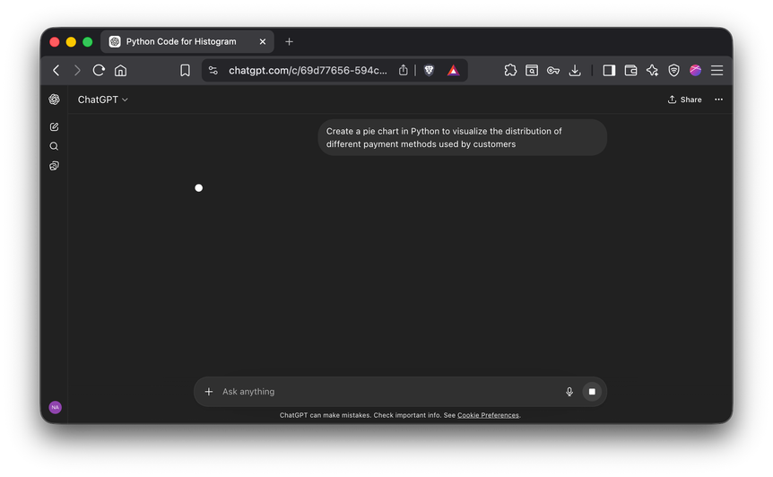
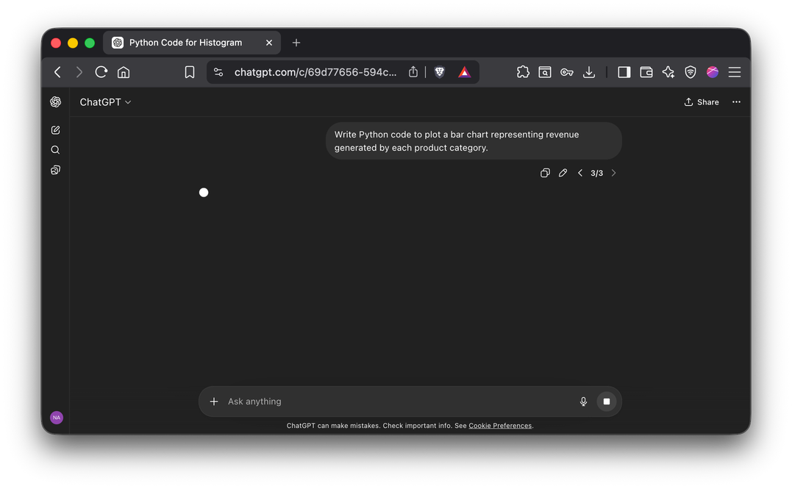
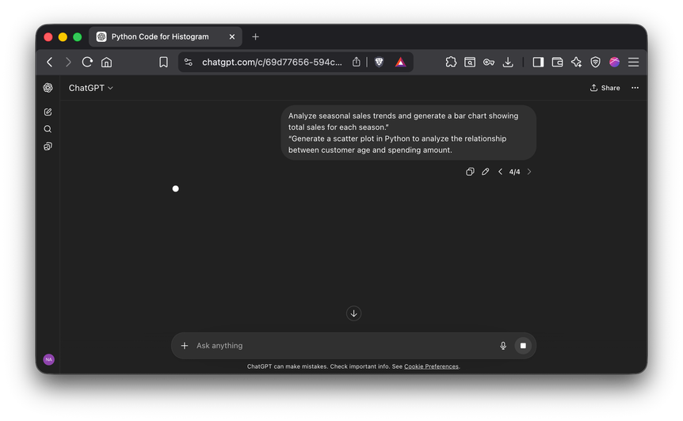
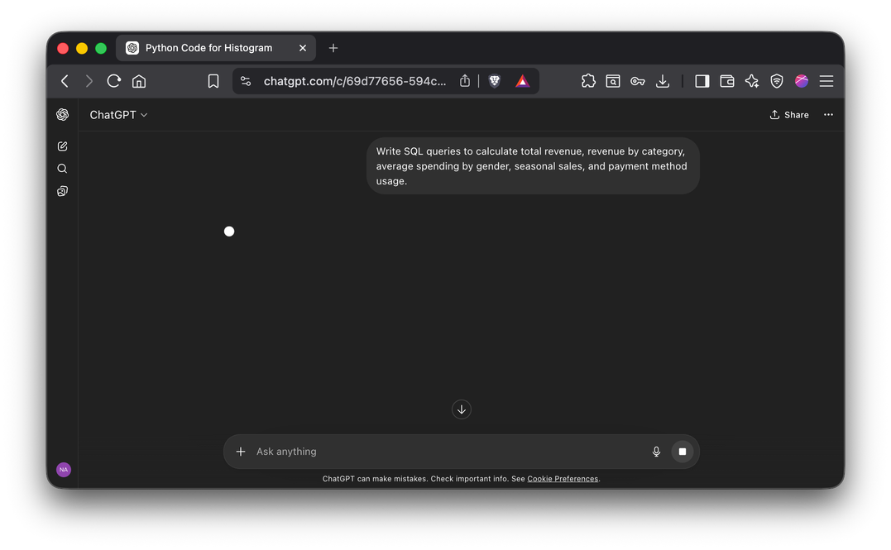
Visual evidence of AI code generation

Slide 11

References
Essential Resources for Customer Shopping Behavior Analysis
To conduct a comprehensive analysis of customer shopping behavior, we utilized various resources including the dataset titled customer_shopping_behavior.csv, extensive Python libraries, and SQL documentation. Additionally, our work was supported by Jupyter Notebook resources, ensuring effective implementation of data analysis techniques.

